Slide 1



JITAM
JITAM
JUST IN TIME
ACCESS MANAGEMENT
Presented by: John Eric Engana

Slide 2


PROBLEMS
LIMITED DEVELOPER ACCESS:
POTENTIAL RISKS DURING ACCESS:
Developers are restricted to accessing only development environments and are not allowed to access production servers and databases under normal circumstances.
Granting temporary access to production environments poses a risk if not properly managed, as it could lead to unauthorized changes, security breaches, or errors.
LACK OF EFFICIENT ACCESS CONTROL MECHANISM
There may be a lack of an efficient and controlled mechanism to grant and revoke this temporary access, potentially leading to delays in resolving production issues or challenges in maintaining security and compliance.

Slide 3







KEY FEATURES
Request Access to prod servers
Developers can request temporary access to production servers and databases.
Access requests can specify a duration (e.g., 1 to 8 hours).
Approval Process
Requests are sent to a manager or an automated system for approval.
Access is granted only after approval to ensure security and oversight.
Time-Limited Access
Once approved, access is granted for a specified period.
Access is automatically revoked after the time expires, reducing the risk of unauthorized changes.
Time-Limited Access
All access requests, approvals, and actions taken during the access period are logged.
Logs can be reviewed for auditing and security purposes.

Slide 4

WORKFLOW
Developer Identifies Issue
A developer or QA found a bug in the production environment.
The developer submits an access request, specifying the duration needed (e.g., 2 hours)
Request Access
Approval
A manager or automated system reviews and approves the request.
The developer receives temporary access to the necessary servers/databases.
Access Granted
Access Granted
Fix the Issue
The developer works on fixing the bug within the given timeframe.
Fix the Issue
After the specified time, access is automatically revoked.
Access Revoked
Logs of the entire process are available for review to ensure compliance and security
Review Logs

Slide 5

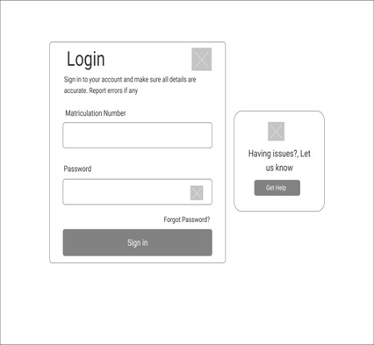
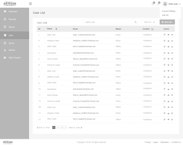
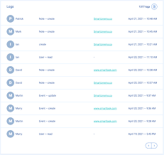

WIRE FRAMES
sample wireframes for the application
Login
Main Content Area
Main Content Area

Slide 6
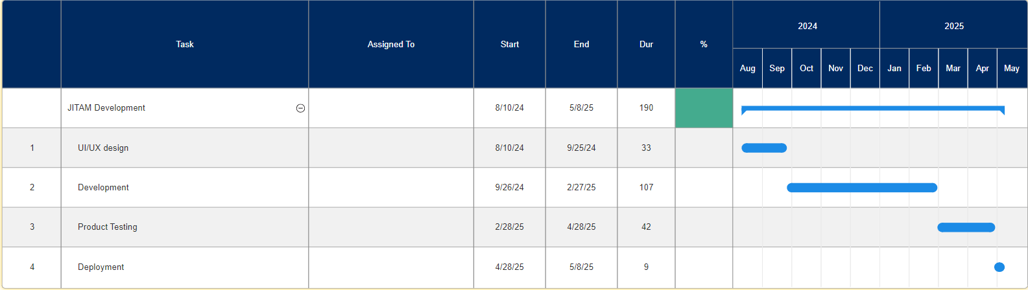
TIMELINE

